Slide 1
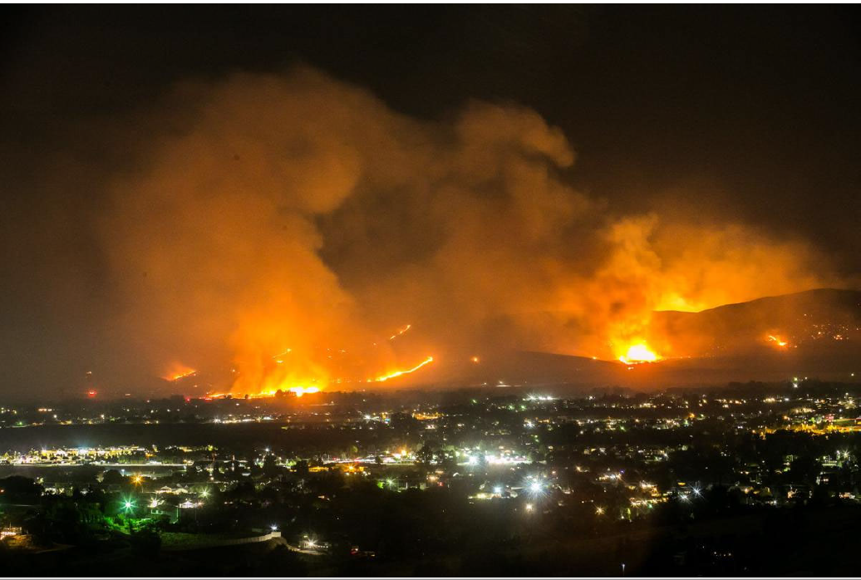
Fire Management Assistance
Grant Program

Slide 2
FMAG Purpose
Federal grant funding to reimburse costs associated with suppression and emergency protective measures for a declared fire
FMAGP effective October 30, 2001
For wildland fires – forests and grasslands, public or private lands
Notes:
Stafford Act Section 420 Rule implementing FMAG is effective 10/30/2001

Slide 3
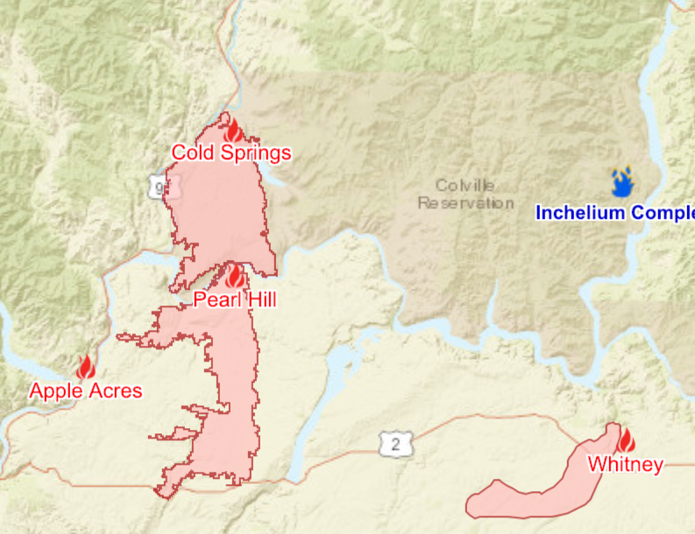
Threat of a Major Disaster
The potential impact of a fire or fire complex is of such a severity and magnitude that it would result in a presidential major disaster declaration for the Public Assistance Program, the Individual Assistance Program, or both.
7-8 September 2020

Slide 4
Collaborative Effort
FMAG declarations require coordinated effort between FEMA and WA State Agencies, Local Jurisdictions, the USFS Principal Fire Advisor, and the National Interagency Fire Center (NIFC)
Timing Critical - State or Indian tribal government must submit a request for fire management assistance declaration to the FEMA Regional Administrator while the fire is:
Burning uncontrolled, and
Threatens such destruction as would constitute a major disaster – lives, improved property, critical facilities/infrastructure, critical watersheds
Notes:
When an uncontrolled fire on non-Federal public or private forest or grassland is such a threat that, in the opinion of the on scene commanders or other government officials, the fire threatens such destruction that would constitute a major disaster, the Governor may request assistance from the FMAGP.
Declaration Criteria
Threat to lives and improved property, including threats to critical facilities/infrastructure, and critical watershed areas;
Availability of State and local firefighting resources;
High fire danger conditions, as indicated by nationally accepted indices such as the National Fire Danger Ratings System;
Potential major economic impact.

Slide 5
FMAG Coordination
Many times, FMAG program staff work on federal fire declarations with no SEOC activation
DNR fires – Many times A&WC isn’t notified. FMAG staff called directly by DNR
State Mobe – When Mobe is approved and WSP staff are activated, FMAG program staff work with WSP staff and Fire IC to evaluate FMAG threat level
SEOC activations for fire seasons used to be considered highly unusual. Now SEOC activates annually for fire season
FMAG Staff monitor social media, scanner traffic, and news sources for early information on fires

Slide 6
WA State Fire Service Resource Mobilization (Mobe) & FMAG
MOBE ≠ FMAG
State Mobilization:
WA State Program
Must be requested by a Fire Chief
Must be burning on or immediately threatening district lands
Local and mutual aid must be exhausted
Regional Fire Coordinators assist with request coordination
Approved by WSP Chief
Fire service resources only
Reimbursement from authorization time to MOBE end time
FMAG:
Federal Program
Federal fire must be requested by Governor or authorized rep
Must be threatening to cause major disaster
EMD/DNR have GARs and coordinate requests
Approved by FEMA Regional Administrator
Fire service and emergency response
Incident period tied to threat to homes and infrastructure

Slide 7
Washington FMAG Declaration Process
Fire Starts
Gain Situational Awareness and conduct a threat assessment
(Local Information Essential)
Complete FEMA FMAG Request Forms
(Local Information Essential)
If the request is approved, The fire is declared a federal fire with FMAG and HMGP-Post Fire funding authorized.
WA EMD staff gain consensus from WA DNR and WSP on 100% containment & incident period end time and send for PFA and FEMA Region X approval.
State coordinates with regional partners to provide fire specific information and status of statewide “firescape” to the PFA and FEMA Region X
(Local Participation Essential)

Slide 8
FMAG Funding
Reimbursement Grants:
75% federal funding
Non-federal 25% share is the Applicant’s responsibility
There is often a state match (12.5%)
Only available in the declared counties following the Declaration
Eligible Participants:
Public entities (State agencies, counties, cities/towns, & special purpose districts)
PNPs, Businesses, & Individuals excluded
Notes:
The FMAGP is a cost reimbursement program for actual fire-fighting costs or emergency protective measures. The FMAGP does not reimburse costs for permanent repairs to any structures or sites damaged or destroyed by fire. The FMAGP is a 75% federal and 25% applicant share grant program.
More details on page 8

Slide 9
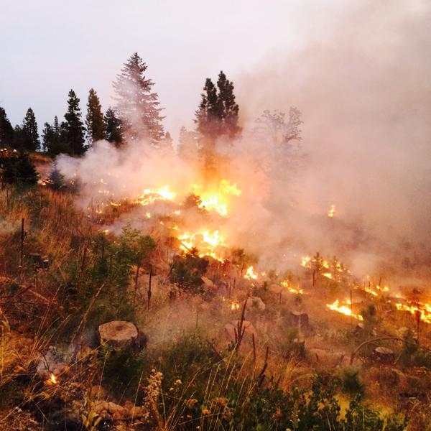
Eligibility Requirements
The activities performed must be:
The legal responsibility of the applying entity
Within the incident period, or required as the result of the declared fire
Located within the designated area or related to firefighting activities (i.e., EOC or dispatch)

Slide 10
Eligible Costs
Within Incident Period
Emergency Protective Measures
Firefighting Activities
Outside the Incident Period
Pre-positioning costs
Temporary repairs due to firefighting activity damages
Mobilization and demobilization
Grant Administration
Notes:
More details on page 4

Slide 11
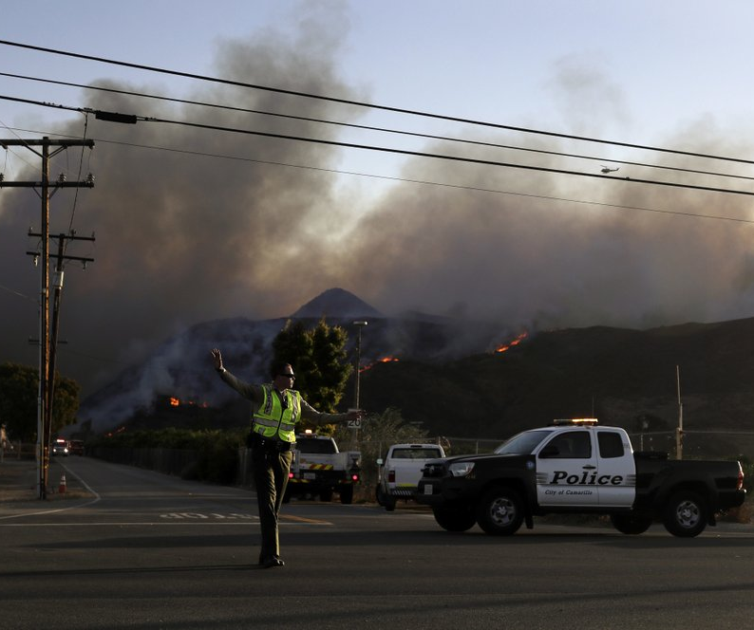
Categories of Eligible Costs
Category B (Emergency Protective Measures)
Evacuations
Public Messaging
Water Pumping
Road Barricading
Overtime Labor
Category H (Fire Suppression)
Firefighting (Overtime & Non-budgeted Volunteer Stipends)
Equipment Time & Repairs directly related to the declared fire
Materials & Supplies, Meals, Uniforms used/damaged as a direct result of the declared fire
Contract crews and equipment
Also available to:
Law Enforcement
County/Local EM
Public Works
and others…
Notes:
More details on page 4

Slide 12
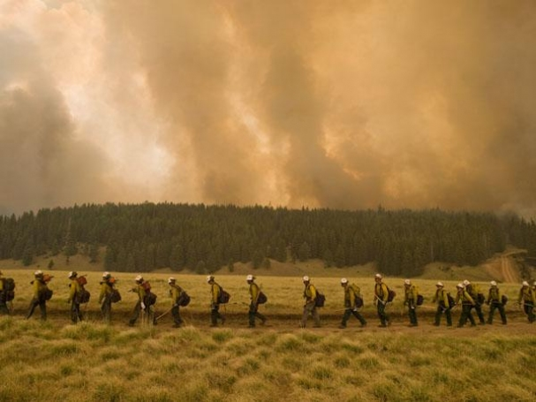
Ineligible Costs
Costs not associated with the incident period
Land rehabilitation
Costs for pre-suppression activities and recovery
Costs for straight time salaries & benefits
Costs that are reimbursable by a federal agency under another statute
Permanent repairs, building
contents, insurable losses, etc.
Notes:
More details on page 4

Slide 13
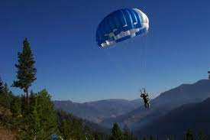
Mutual Aid
Incident Commander must have requested services
Written and unwritten agreements
Unwritten must be documented immediately after the incident
Providing entity costs are treated as contract costs
Cannot be intra-organization

Slide 14
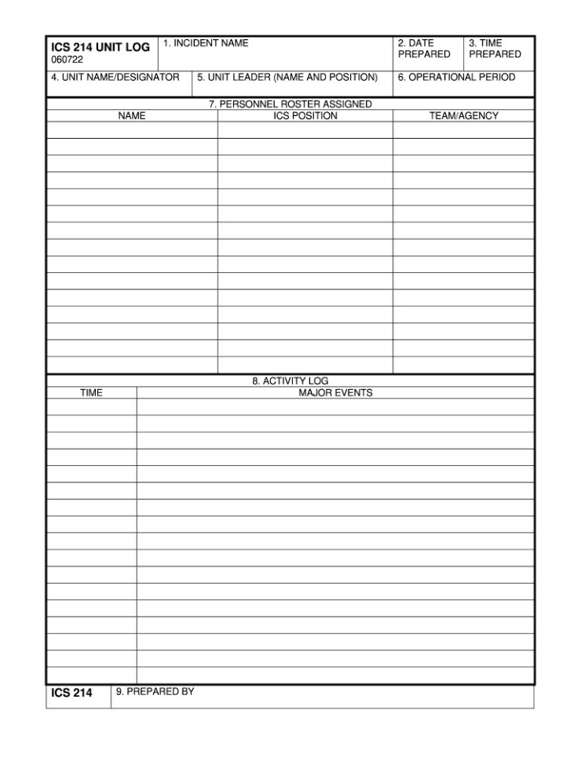
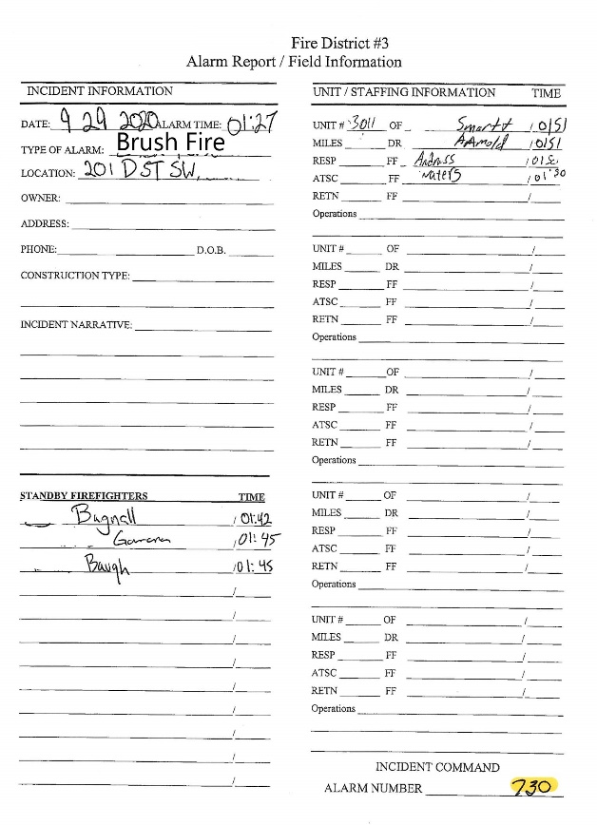
Cost Documentation
2 CFR 200: Uniform administrative requirements, cost principles, and audit requirements for Federal awards
Regulatory requirement to provide documentation of costs
Documentation of costs:
Dispatch records
Field notes
Vehicle logs
Pay records
Time sheets/Records
Invoices/Purchase Orders
Verbal narrative insufficient

Slide 15
FMAG/PA PROCESS - DUAL TRACKS
Apply (RFMA)
(Grant Writing)
(Grant Admin)
Recovery Scoping Meeting
Project (Cost) Documentation
Applicant Agent Designation
State Review
Grant Agreements
FEMA Review
Finance/Admin Documentation
Fed $$ Obligated
Project Records & Payment Prep
Payment
Record Keeping

Slide 16
HMGP Post Fire
2021 Funding: $8,306,965 ($1,038,371 per FMAG declaration)
Prioritized to the jurisdiction where the fire occurred
Grant program aimed at reducing long-term wildfire risks & impacts
Cost-Share: 75% Federal, 12.5% State, 12.5% Local
Eligibility: Public entities with FEMA-approved Hazard Mitigation Plans, and qualifying non-profits
Period of Performance: 3 years
Projects do NOT have to occur on burned land

Slide 17
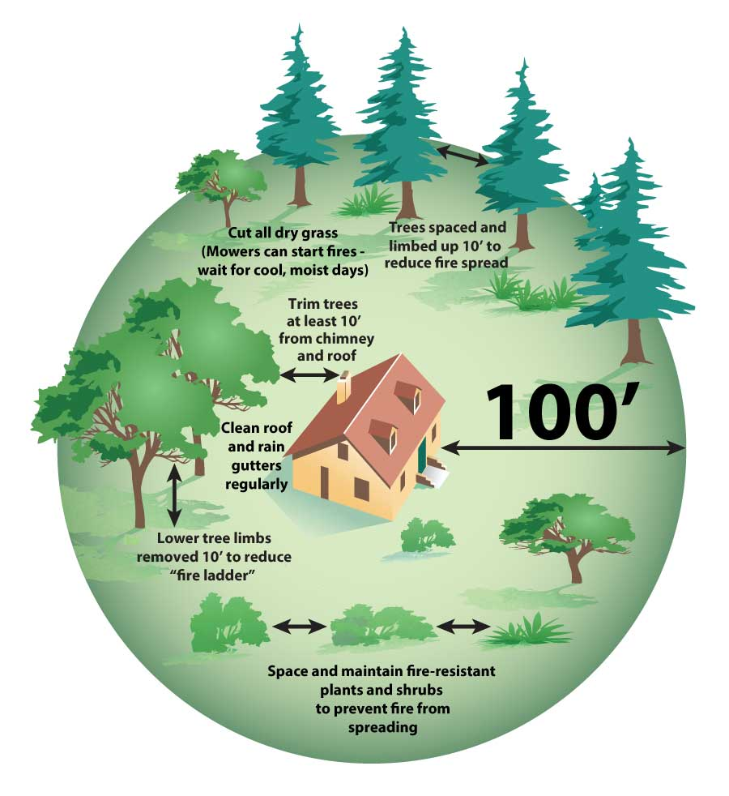
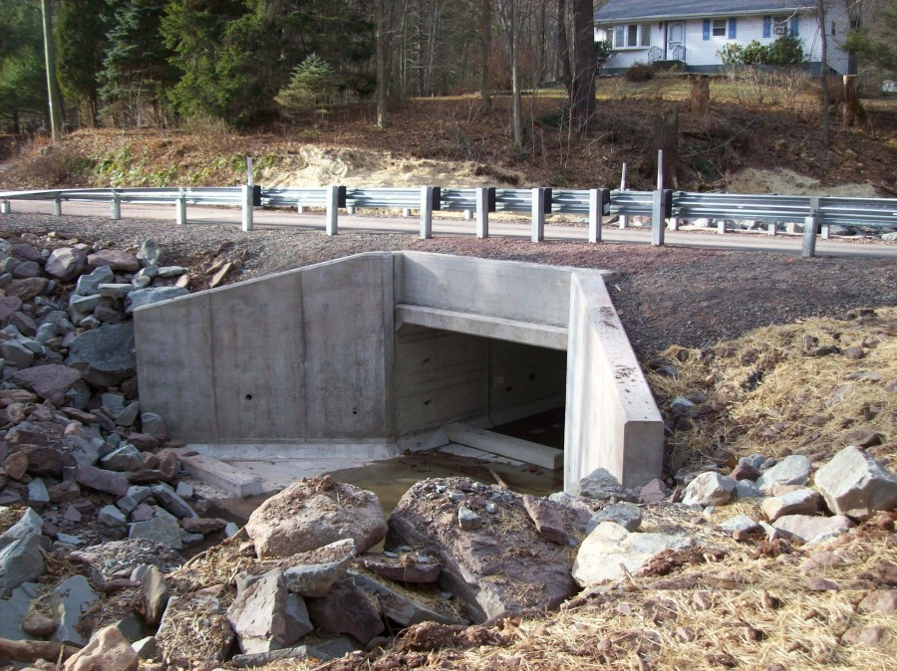
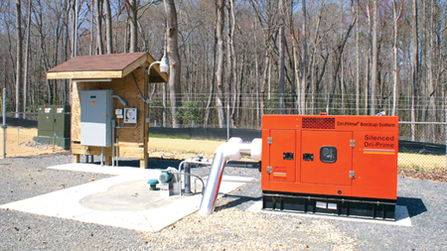
Parting Shot … HMGP – Post Fire
HMGP Post Fire – Project Examples
Increased Flood Risk
Culvert upsizing
Storm drain system improvements
Long-term erosion control
High-Risk WUI Neighborhoods
Hazardous Fuel Reduction
Defensible Space work
Ignition-resistant home retrofits
Infrastructure & Essential Services
Emergency back-up generators
Facility fireproofing and hardening
Visit https://mil.wa.gov/grants or email HMA@mil.wa.gov for more information
POC: Tim Cook, tim.cook@mil.wa.gov or (253) 512-7072

Slide 18
FMAG Program – Section Staff
FMAG Section Staff
Catharina “Cat”Whipple | catharina.whipple@mil.wa.gov | chris.polit@mil.wa.gov | (253) 345-0436
Amy Mampreian | amy.mampreian@mil.wa.gov | elizabeth.byrd-rand@mil.wa.gov | (253) 640-4868
Kristin Moerler | kristin.moerler@mil.wa.gov |  | (253) 355-8418
Geoff Phillips | geoffrey.phillips@mil.wa.gov |  | (253) 355-5600
Joseph Price | joseph.price@mil.wa.gov |  | (253) 512-7144
Program Assistant | TBD |  | TBD
Helen Fortune |  | helen.fortune@mil.wa.gov | (253) 512-7424
Alternate POCs
Gary Urbas |  | gary.urbas@mil.wa.gov | (253) 512-7402
Kelly Thomas |  | kelly.thomas@mil.wa.gov | (253) 512-7123
Jon Holmes |  | jon.holmes@mil.wa.gov | (253) 512-7429
Eric Cunningham |  | eric.cunningham@mil.wa.gov | (253) 512-7408

