Slide 1
Catastrophic Incident Annex
Cascadia Rising 2022
EMERGENCY MANAGEMENT DIVISION
“A disaster-ready and resilient Washington State”
Appendix 2-2
Community Lifelines
Senior Leadership Brief
Tier 1 Reporting

Slide 2
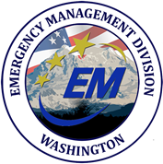

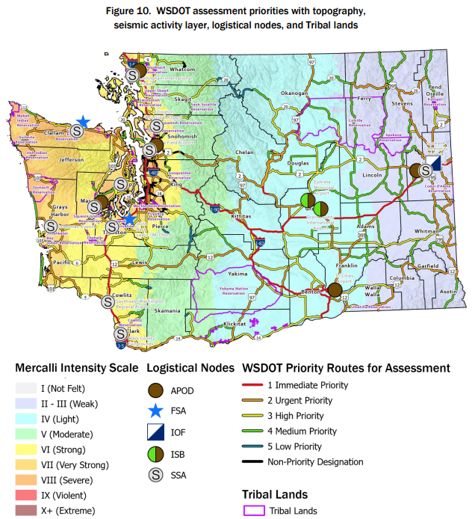
Slide 1
Washington State Emergency Management Division Senior Leadership Brief
Cascadia Rising 2022
June 13-15, 2022 (0800/PST)
Current Situation
On June 9, 2022, a 9.0 magnitude Cascadia Subduction Zone (CSZ) earthquake has ripped along the 700-mile CSZ fault line with no epicenter. The ground shook for four to six minutes. Some areas along the coast dropped three to nine feet in elevation. Coastal areas experienced the highest intensities and the level of shaking diminished farther inland; numerous aftershocks continue to disrupt response efforts. Inundation was experienced on the shorelines of counties in the upper Puget Sound and Strait of Georgia. Over 163,000 Washingtonians resided in the tsunami inundation zone. After the initial ground shaking, survivors had as few as 10 minutes before the first wave made landfall. Coastal areas received as many as three waves in the first hour and subsequent waves
continued for nearly 18 hours.
The Governor has signed a disaster proclamation, and the President has approved a major disaster declaration.
Lifelines: Impacts and Actions
Safety and Security | All | Government services are overwhelmed after the earthquake.
 | Coast | Impacts to all other lifelines hamper the ability for government to provide basic services, like firefighting and other life-saving services
 | I-5 | Impacts to all other lifelines hamper the ability for government to provide basic services, like firefighting and other life-saving services
 | East | In Eastern Washington, communities have responded to local impacts internally as they arise. Some isolated communities may exist, potentially along the eastern slopes of the Cascades.
Food, Water, Shelter | All | Supplies like drinking water, food, hygiene, and other necessary household items are scarce.
 | Coast | Over 450,000 displaced survivors are in immediate need of short-term sheltering, and over a million people need feeding and hydration – including their pets. 100% of Coastal and 89% of I-5 Corridor potable water facilities have sustained medium to high damage. Estimates indicate that between 5,000 and 29,000 people have been injured, and between 9,100 and 16,578 have been killed in the Coastal Region.
 | I-5 | Over 450,000 displaced survivors are in immediate need of short-term sheltering, and over a million people need feeding and hydration – including their pets. 100% of Coastal and 89% of I-5 Corridor potable water facilities have sustained medium to high damage.
 | East
Health and Medical | All | Over 19,000 survivors with varying degrees of injuries have attempted to access hospitals.
 | Coast | Most hospitals have suffered medium to high damage, which has resulted in the loss of hundreds of regular and critical beds. Medical and health care capabilities are severely disrupted. Some providers may be able to operate from tents Some of the hardest hit areas may only be accessible by helicopter
 | I-5 | Most hospitals have suffered medium to high damage, which has resulted in the loss of hundreds of regular and critical beds.
 | East
Key Updates | SEOC Activation Level: 1 (Full Activation) COOP Activation Phase: 2 (Activation and Relocation) State/Local Response: Currently, there is no coordinated common operating picture/situational awareness available in the tribes and communities regarding the impacts of the earthquake’s aftermath. Based on prior planning, most communities should have an idea of where damages have occurred; however, damage to the transportation system is limiting the ability to conduct road, highway, and bridge damage assessments. Tribes and local jurisdictions are responding with internal resources; however, the severity could rapidly exhaust local capabilities. An Initial Operating Facility (IOF) has been established in Spokane as well as an Aerial Port of Debarkation at Fairchild Air Force Base. FEMA has established an Incident Support Base (ISB) at Moses Lake. The response is causing a mass influx of federal and state resources into the area. Airfields at Yakima, Tri-cities, and Wenatchee may be operational, but power is intermittent at times.
Lifelines: Impacts and Actions
Energy | All | After the earthquake, large regions of Washington experienced complete blackout conditions.
 | Coast | 100% of Coastal energy infrastructure has sustained medium to high damage
 | I-5 | 78% of I-5 Corridor energy infrastructure has sustained medium to high damage.
 | East | Power is in the process of being restored in impacted communities east of the Cascades.
Communication | All | Up to 6 million people have lost access to standard communication services immediately after the earthquake. Lack of communication networks limit ongoing situational assessments.
 | Coast | 67% of Coastal communications systems are likely damaged beyond repair.
 | I-5 | 21% of I-5 Corridor communications systems are likely damaged beyond repair.
 | East | Facilities in eastern Washington have suffered minimal damage, but low availability of power will limit the capability of these facilities.
Transportation | All | 5,655 miles of highway have sustained medium to high damage or are inaccessible requiring repair or clearance. 30% of bridges have sustained damage, and roughly 20% have collapsed or are in imminent danger of collapse.
 | Coast | US 12, SR 4, SR 6, SR 8, SR 103, SR 104, SR 105, SR 109, SR 112, and SR 113 may not be usable. All bridges on US 101 are suspected to have failed. Damages to the transportation system have created isolated communities within impacted jurisdictions.
 | I-5 | Major river valleys have damaged or destroyed bridges along their lengths, including I-5 at the Columbia and Nisqually Rivers. I-5 is believed to be useable in places, but significant gaps exist. I-405, SR 99, SR 18, SR 16, and other large connectors may be impassable. I-90 over the pass is open to one lane in both directions (using the eastbound lanes), but traffic is moving very slowly – less than 10 MPH. Stevens Pass is closed and may not reopen for multiple weeks. White Pass may reopen in the next few days but will struggle to connect with I-5.
 | East | US 97 North of Wenatchee is closed due to landslide activity and fallen rocks. The closure is impacting the Confederated Tribes of the Colville Reservation lands near Lake Chelan. US 97 through Status Pass is also closed due to landslide activity, impacting access into portions of the Yakama Nation and preventing travel between Goldendale and Toppenish. I-82 bridges between Ellensburg and Yakima need complete inspections before being reopened, and SR 821 through Yakima Canyon is closed.
Hazardous Waste | All | Over 1,000 facilities in impacted areas of Washington and Oregon contain extremely hazardous substances (EHS). 3,000 facilities in Washington have reportable quantities of less dangerous material.
 | Coast | 100% of Coastal wastewater facilities in suffered medium to high damage.
 | I-5 | 88% of I-5 Corridor wastewater facilities in suffered medium to high damage.
 | East

Slide 3
Slide 1
Washington State Emergency Management Division Senior Leadership Brief
INCIDENT NAME
Date (TIME/ZONE)
Current Situation
Lifelines: Impacts and Actions
Safety and Security | All
 | Coast
 | I-5
 | East
Food, Water, Shelter | All
 | Coast
 | I-5
 | East
Health and Medical | All
 | Coastal
 | I-5ern
 | Eastern
Key Updates | SEOC Activation Level: COOP Activation Phase: State/Local Response:
Lifelines: Impacts and Actions
Energy | All
 | Coast
 | I-5
 | East
Communications | All | .
 | Coast
 | I-5
 | East
Transportation | All
 | FL
 | AL
 | GA
Hazardous Waste | FL
 | AL
 | GA

