Slide 1
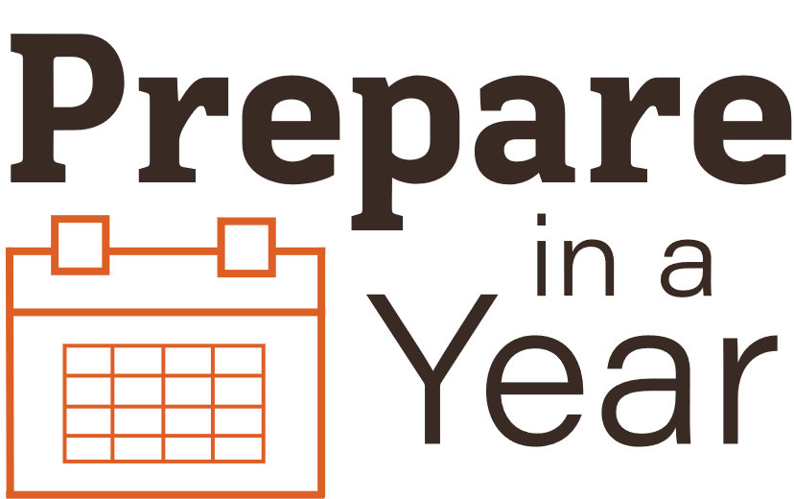
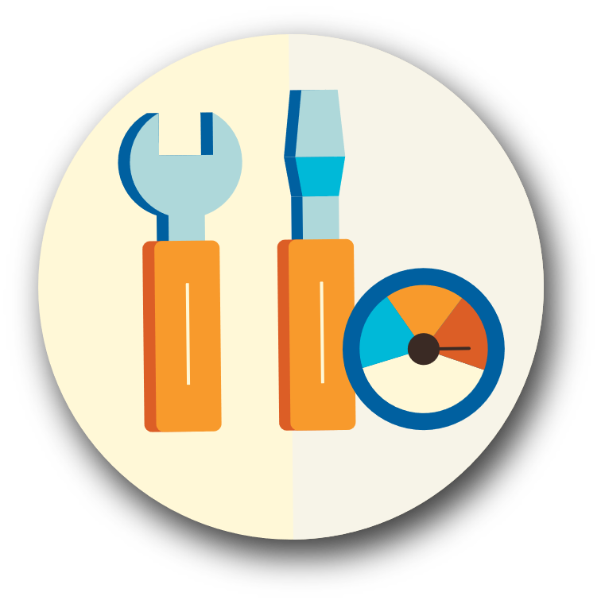
Learn Utility Safety

Slide 2
Natural Gas
Natural gas leaks and explosions are responsible for a significant number of fires following any major earthquake.
Know the signs of a gas leak, don’t shut off the gas if there isn’t a leak
Attach a wrench to the meter or to the wall directly behind the meter.
Make sure all responsible household members know when and how to shut off gas at the meter

Slide 3
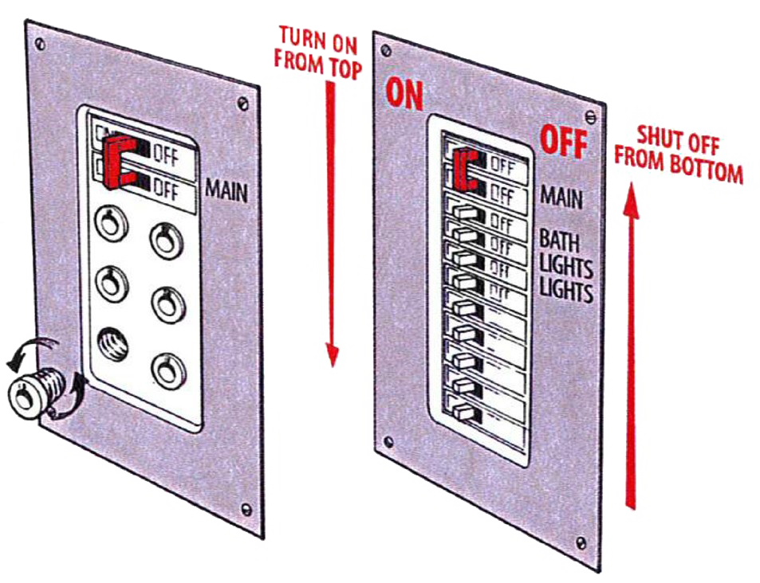
Electricity
Check the cords, plugs, and connectors
Locate your electricity circuit box
Teach all responsible household members how to shut off the electricity to the entire house

Slide 4
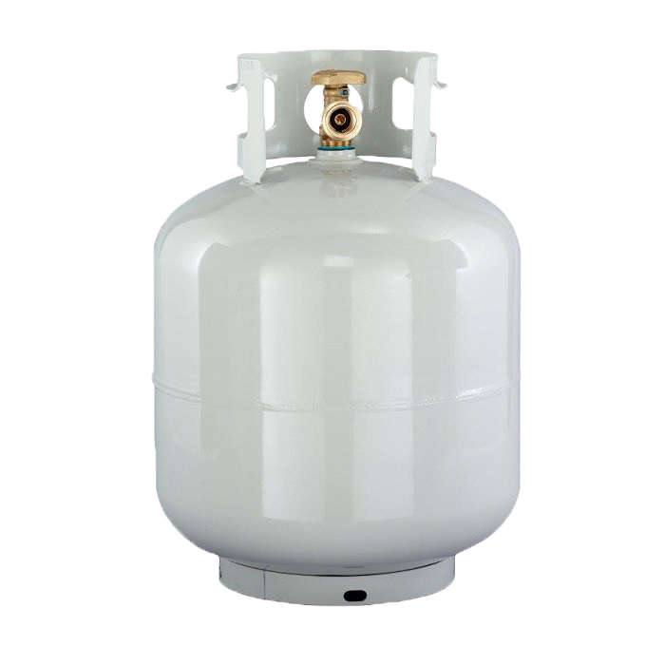
Propane
Have your home’s propane tank properly installed by a qualified professional and serviced on a regular basis.
Propane tanks are extremely flammable.
Never use or store a propane tank indoors
Do not use portable propane heaters, stoves, or lanterns in tents, campers, truck caps, RVs, or other unventilated enclosures, especially while sleeping.

Slide 5
Use the Web
ready.gov
mil.wa.gov/preparedness
Local Resources
Check with local utilities, the local fire department, or local emergency management about location specific utility hazards in your area.

