Slide 1
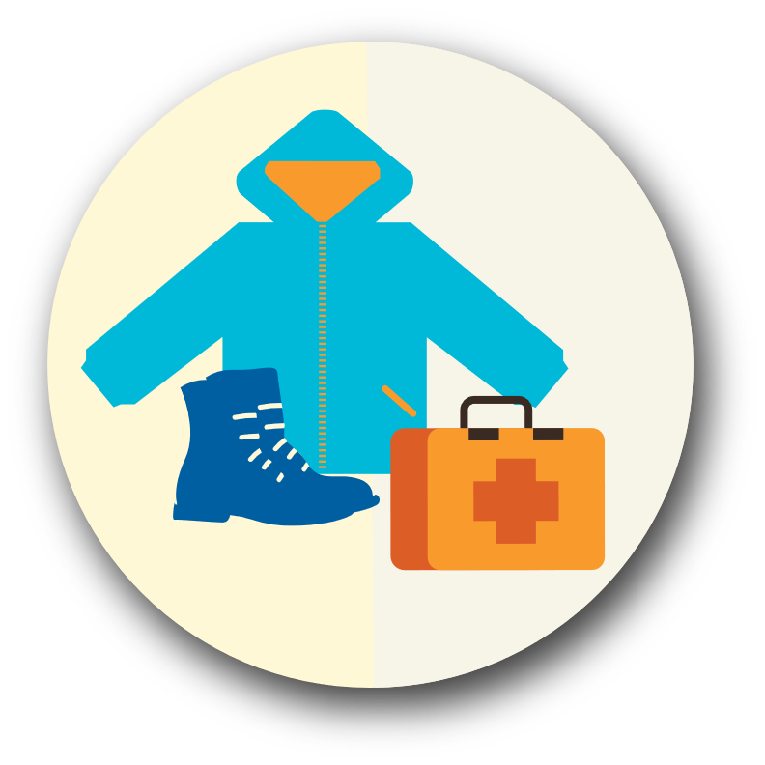
Under the Bed

Slide 2
Day or night: Ready to respond
When disaster strikes, it may be difficult to think as rationally as in normal conditions.
The more procedures you have in place, and the easier they are to remember and implement, the more effective and efficient will be your response.

Slide 3
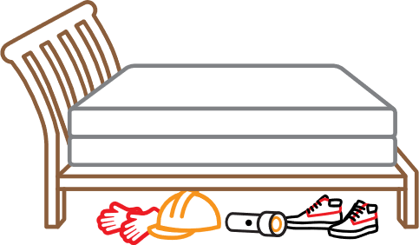
Critical Under the Bed Items
Sturdy shoes — to protect your feet from broken glass
Work gloves, preferably leather — to protect your hands from broken glass
Flashlight & light sticks — essential for a nighttime response

Slide 4
Additional Recommended Under the Bed Items
TIP:
QUICK TIP: Keep it simple. Instead of throwing them away, put your old tennis shoes or garden shoes under your bed!
Hard hat — to protect you from falling objects like chimney bricks, and downed trees and branches. Bicycle helmets also work.
An OK/ HELP card or a sheet of paper and marker for you to write on yourself.
Tape or adhesive bandages to hang the OK/ Help card in the window or on the front door.
Place a copy of your out-of-area contact card in a plastic bag.
A whistle (to call for help).

Slide 5
We recommend that you keep these basic response supplies under the bed. That way, day or night, you’ll know where to go to get the essentials.

