Slide 1
Shelter in Place

Slide 2
What does shelter in place mean?
Sheltering in place is creating a “safe room” in your home.
A shelter-in-place order is generally because of a volcanic ash, chemical, biological or radiological threat.
accidents involving transport trucks or trains, from terrorist acts or even as a result of a fire at an industrial area

Slide 3
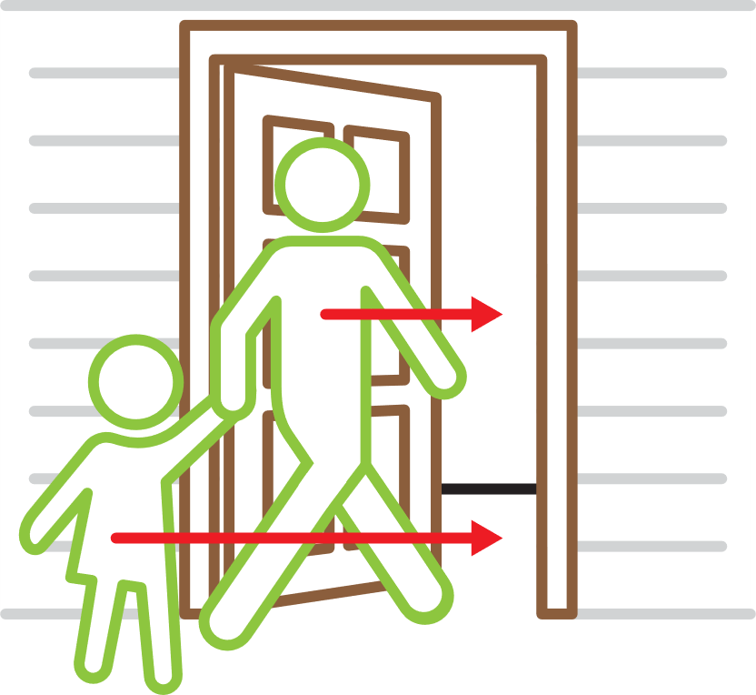
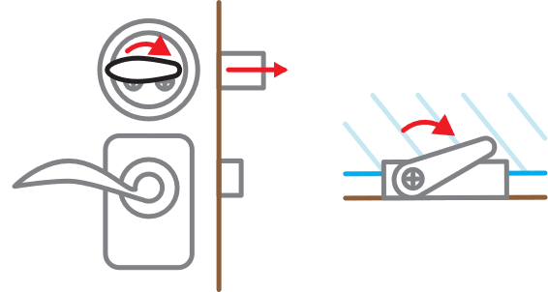
1. Go inside immediately
Remember your kids and pets.
2. Tightly lock all doors and windows
The faster you do this, and the more tightly, the less likely contaminants will get inside.

Slide 4
3. Shut off fans and devices that circulate air throughout your home.
Shut off fans.
If a fire is lit, put it out. Shut the vents and doors.
Tightly close wood stove and fireplace dampers.
Adjust thermostat or furnaces and air conditioners to shut off and stay off.

Slide 5
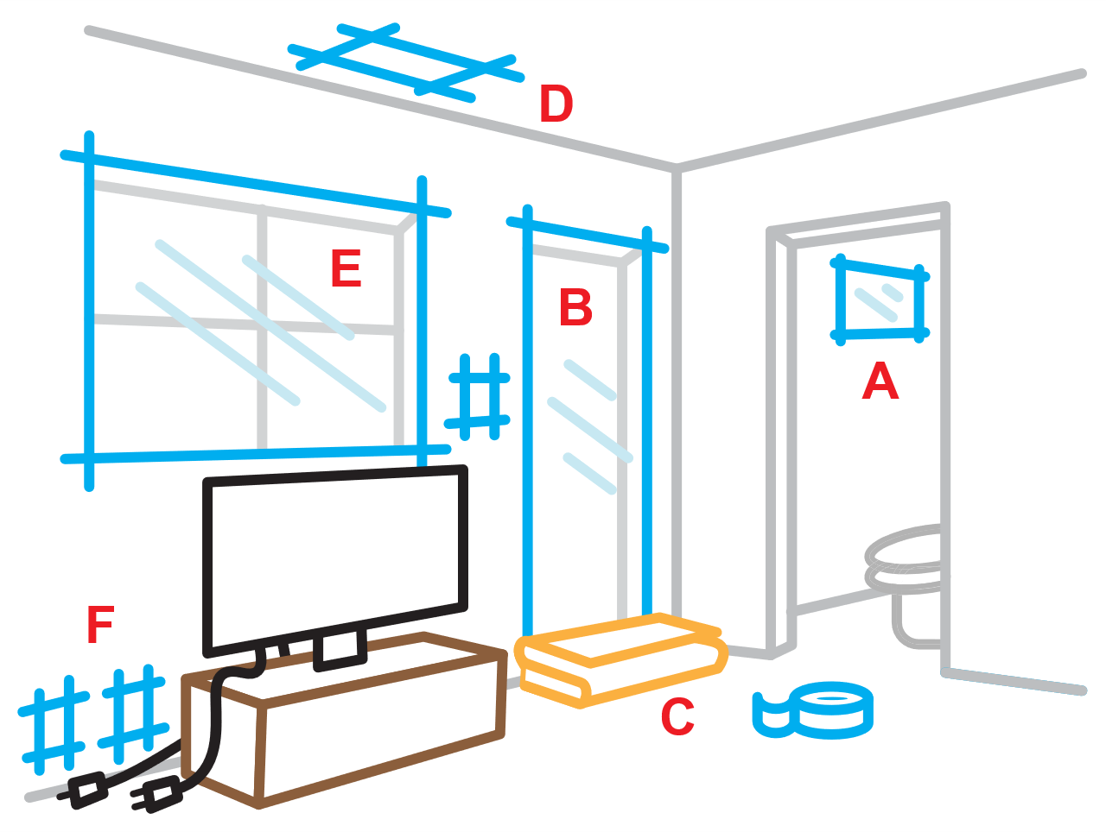
4. Get into your pre-selected room and seal it tightly
Tape plastic sheeting over windows, doors, vents, bathroom fans, electrical outlets. Remember, you are creating a tightly sealed room, so freely use tape.
Place dampened towels under door cracks to tightly seal them.
A. Bathroom Fan.
B. Pre-cut plastic sheeting over door frame.
C. Dampened towels under door to tightly seal.
D. Tape forced-air registers (on ceiling and floor).
E. Pre-cut plastic sheeting over window frame.
F. Tape outlets, TV cables, switches, landline jacks.

Slide 6
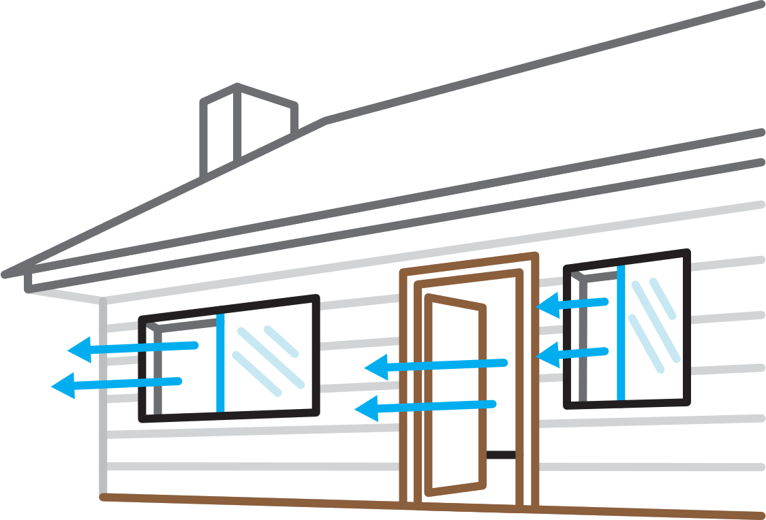
5. Listen to media for instructions.
Use radio, TV or social media to check for official instructions on when it’s safe to come out or whether to evacuate. On social media, only follow trusted sources.
6. Thoroughly air out your home once the emergency is over.
Open your doors and windows. This will allow small particles that may have gotten in to dissipate.

