Slide 1
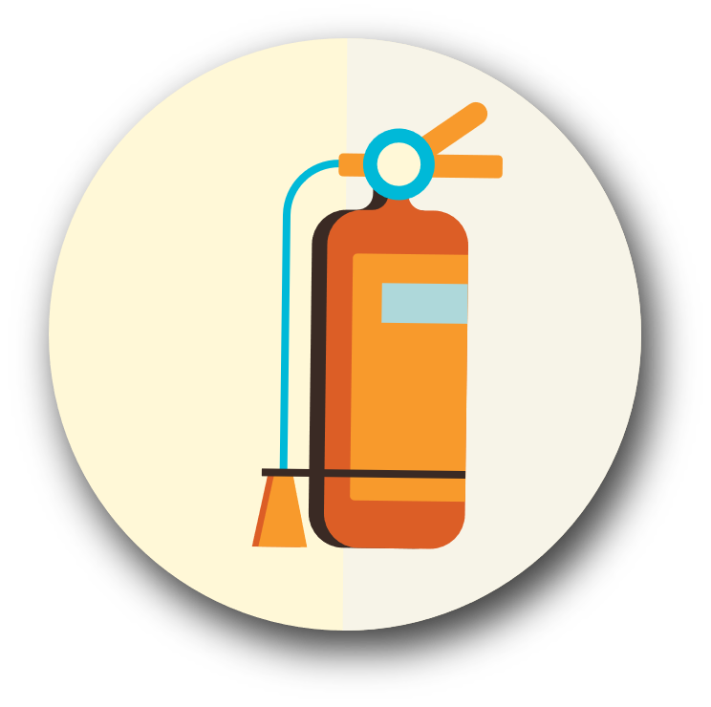
Fire Safety

Slide 2
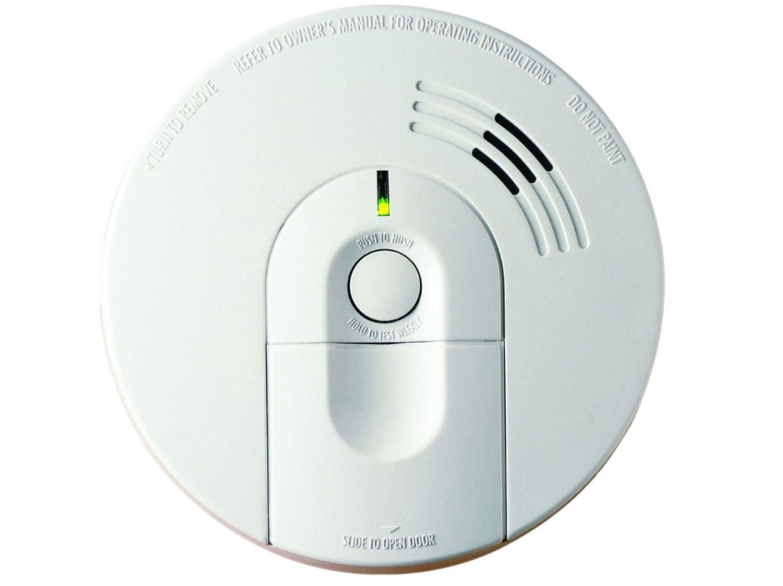
Prevention & Safety
Smoke detectors
Carbon monoxide detectors
Fuel storage
Outside defensible space

Slide 3
TIP:
Prevention & Safety continued
Never use gas ovens, stoves, barbeques or propane heaters for indoor heating
Matches and smoking
Heating sources
Electrical wiring

Slide 4
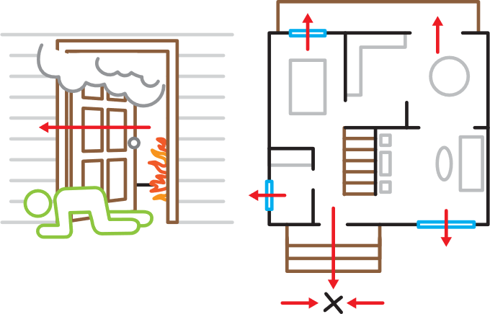
Fire Escape Plans
Make with household members
Household members with special considerations
Practice!

Slide 5
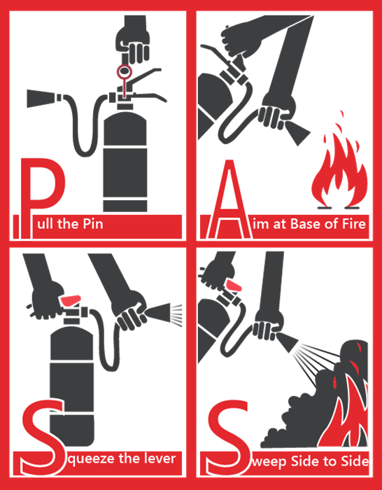
Using Fire Extinguishers
Become familiar with the different types of extinguishers
Does everyone in the house know where they are located and how to use them?
Perform annual or semi-annual maintenance checks on your fire extinguishers

Slide 6
Use the Web
usfa.fema.gov/prevention
mil.wa.gov/preparedness
ready.gov
redcross.org
Local Resources
Check with local the fire department or emergency management office for more resources or training

