Slide 1
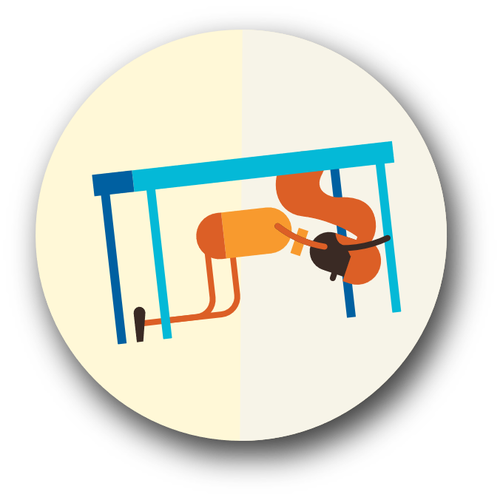
Drop, Cover, and Hold On

Slide 2
Conquering the instinct to run
We learn to counter the human tendency to run by practicing doing the safe thing.
Studies show that people tend to be hurt by falling objects, not collapsing structures.
Facades of buildings or glass from windows can be falling and injure those running out during an event.

Slide 3
DROP – Where you are, onto your hands and knees.
COVER – Your head and neck with one arm and hand. If a sturdy table or desk is nearby, crawl underneath it for shelter. (If no shelter is nearby, crawl next to an interior wall away from windows. Stay on your knees; bend over to protect vital organs).
HOLD ON – Until shaking stops. (Under shelter: hold on to it with one hand; be ready to move with your shelter if it shifts. No shelter: hold on to your head and neck with both arms and hands.) Drop, cover, hold on is the national standard for earthquake safety in our country.

Slide 4
TIP:
Visit dropcoverholdon.org to find advice for persons with access or functional needs.

Slide 5
TIP:
Three steps to take after an earthquake:
Check yourself for injuries.
Check the people around you for injuries.
Check your environment. Is it safe for you to stay where you are?
If driving:
Pull over to the side of the road, stop, and set the parking brake.
Avoid overpasses, bridges, power lines, signs and other hazards.
Stay inside the vehicle until the shaking stops, then proceed carefully by avoiding fallen debris, cracked or shifted payment and emergency vehicles.
If a power line falls on the car, stay inside until a trained person removes the wire.
Near the coast:
IF THE GROUND SHAKES...
IF YOU HEAR A SIREN...
IF THE OCEAN RECEDES FROM THE SHORELINE...
TAKE YOUR PREPARED GRAB AND GO KIT,
IMMEDIATELY - HEAD FOR HIGH GROUND!

Slide 6
What If There’s No Cover?
Drop, Cover, and Hold On BETWEEN OR BESIDE something sturdy.

Slide 7
Use the Web
shakeout.org/washington
dropcoverholdon.org
mil.wa.gov/shakeout
Local Resources
Contact local and state emergency management offices for more information

