Slide 1
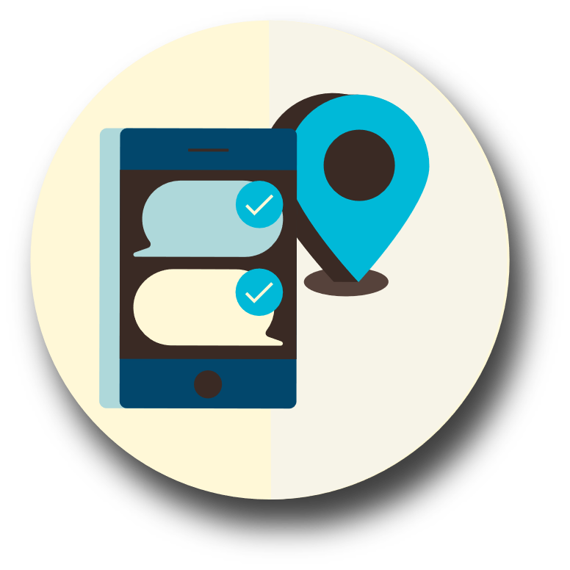
Communications Plan

Slide 2
What does it mean to have a communication plan?
Contact list including out-of-area contact phone number
Know how to contact your friends/family if you don’t have access to your cell phone

Slide 3
COLLECT
Create a paper copy of the contact information for your family and other important people/offices, such as medical facilities, doctors, schools, or service providers.
TIP:
You may be able to send text messages to your loved ones on your cell phone. Keep these messages short.

Slide 4
SHARE
Make sure everyone carries a copy in his or her backpack, purse, or wallet. You should also post a copy in a central location in your home, such as your refrigerator or family bulletin board.

Slide 5
PRACTICE
Have regular household meetings to review and practice your plan.

Slide 6
Use the Web
The American Red Cross has a website that lets you search for loved ones and register yourself as “safe and well.” https://safeandwell.communityos.org/
Facebook has a “safety check” that can be implemented after a disaster. https://www.facebook.com/about/safetycheck/

