Slide 1
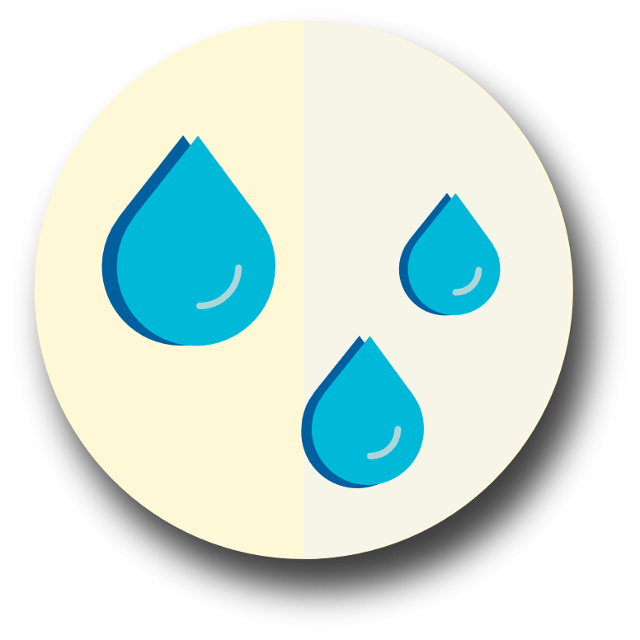
Store Water

Slide 2
How much water do you think you should store per person in your family for 2 weeks?
Answer: For your household, we recommend at least two weeks’ worth of water – one gallon per person and pet per day for drinking, cooking and hygiene needs.

Slide 3
What containers should I use?
Plastic containers with a screw-cap lid, such as two-liter
soda pop bottles or food-grade plastic jugs, work great.
Don’t use glass bottles or old bleach bottles (or any container
that has held a toxic substance).
Avoid the use of plastic milk jugs. (They are difficult to seal
tightly, and their plastic becomes very fragile and brittle over
time).
TIP:
Purify water by adding 5-8.5% bleach.
For 1 gallon of water add either:
8 drops
½ ml
1/8 teaspoon

Slide 4
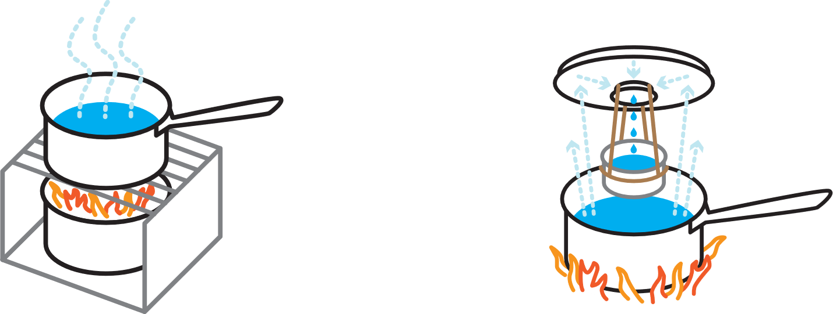
Boiling is the surest method to kill disease-causing organisms, including viruses, bacteria, and parasites.
Distillation –
1. Fill a pot halfway with water.
2. Tie a cup to the handle on the pot’s lid so that the cup will hang right-side up when the lid is placed upside-down on the pot (make sure the cup is not
dangling in the water).
3. Boil the water for 20 minutes. The water that drips from the lid into the cup is distilled.

