Slide 1
Important Documents

Slide 2
After a disaster you may need financial assistance.
Having important documents may help you with this.
The first step is to take an inventory of your household documents, contacts, and valuables.

Slide 3
Gather property insurance papers (home, renter’s, auto, boat, etc.) and make copies.
Gather health insurance papers (medical provider, dental provider, life, extended disability, etc.) and make copies.
Gather financial papers (bank, investment, retirement, etc.) and make copies.
Gather wills, powers of attorney, and estate papers and make copies.
Take photos or videos of all valuables as documentation for insurance claims.

Slide 4
If you have physical copies of your important papers, store these copies and photos in a safe deposit box, fire proof box or in a zipper storage bag in your freezer.
TIP:
Strengthen your financial preparedness
for disasters and emergencies by
downloading FEMA’s Emergency Financial
First Aid Kid at http://bit.ly/EFFAK1

Slide 5
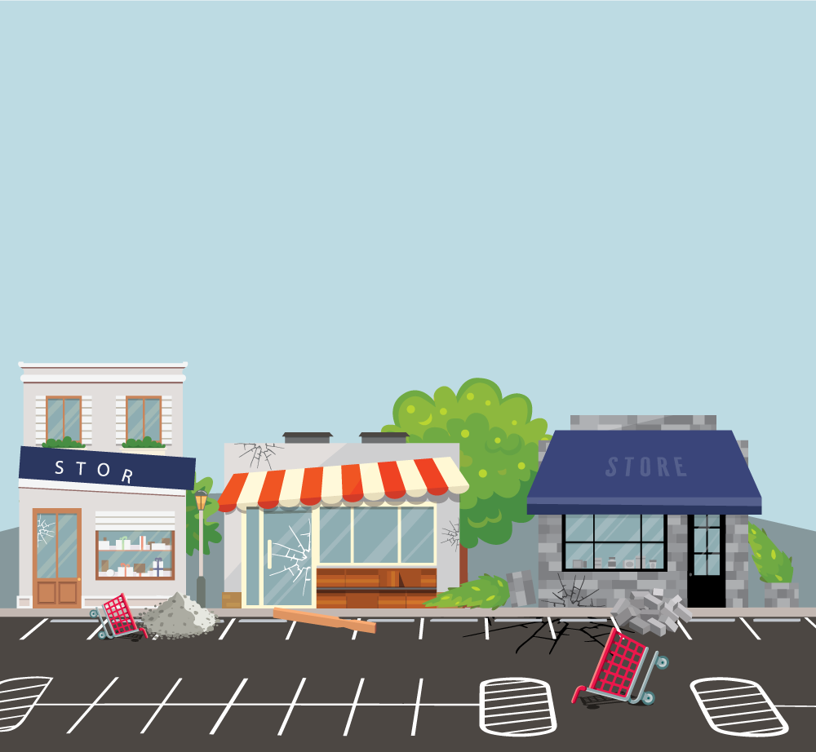
Store electronic copies of important documents in a password-protected format
On a removable flash or external hard drive in your fireproof and waterproof box or safe,
Or consider using a secure cloud-based service.

