Slide 1
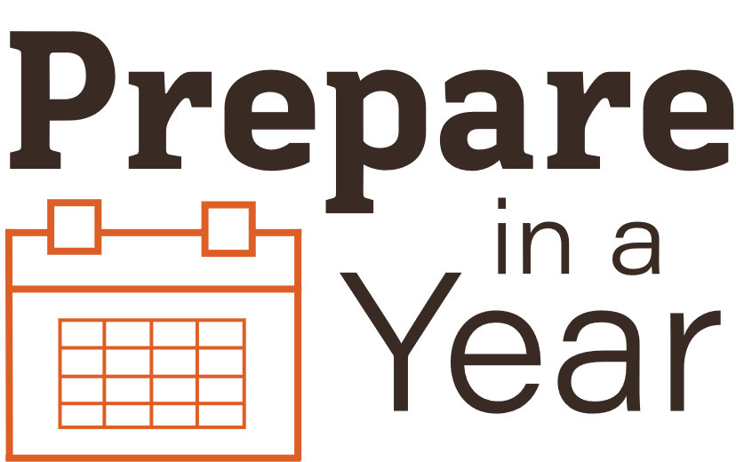
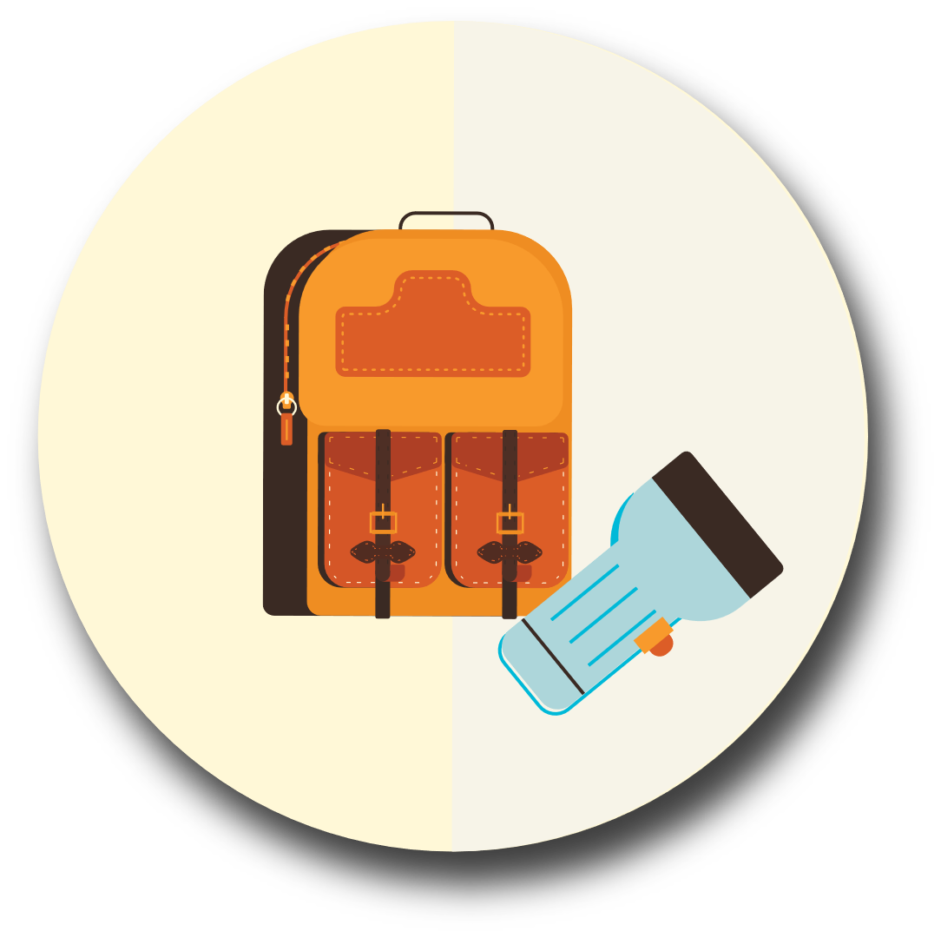
Grab and Go Kit

Slide 2
After an emergency, you may need to survive on your own for several days.
Being prepared means having your own food, water and other supplies to last for several days.
A disaster supplies kit is a collection of basic items your household may need in the event of an emergency.

Slide 3
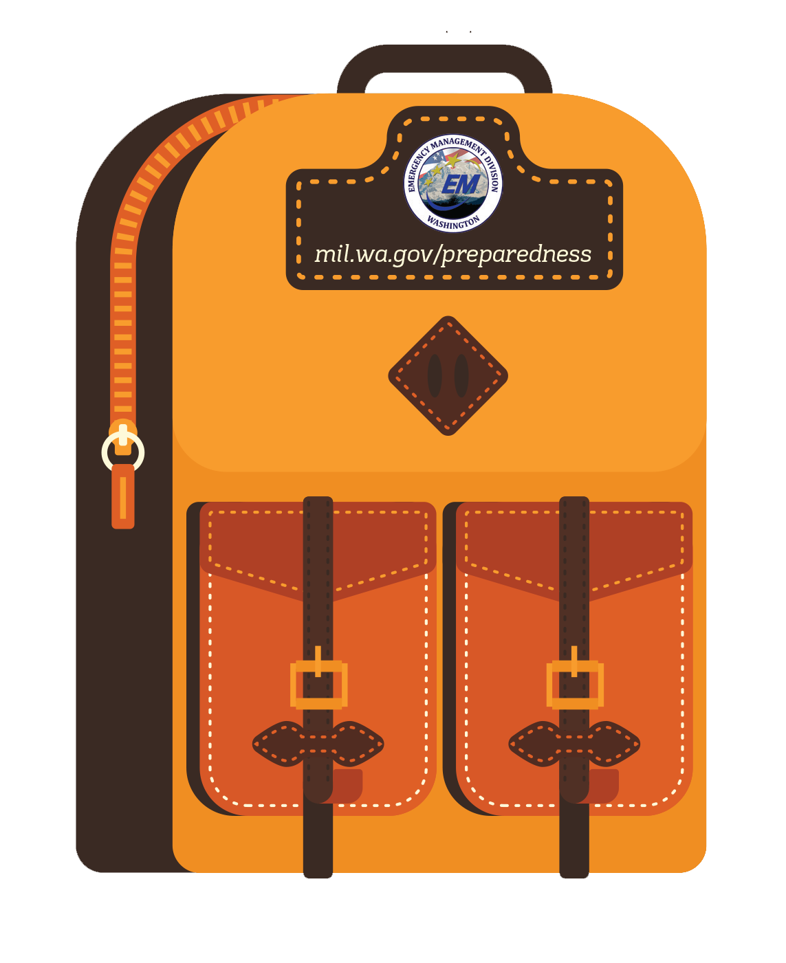
What should go in your kit?
Food
High energy foods — peanut butter, granola bars, trail mix;
Comfort foods — cookies, hard candy, etc.;
Dry meats like beef sticks and jerky.
Water
2-3 days of water.
1 quart per day per person
Clothes
Extra socks
Change of clothes

Slide 4
Other Items
Food
Water
Flashlight
Extra batteries
Light sticks
Radio (battery/crank)
Whistle
Toiletries & wet wipes
Multi-purpose tool
and knife
Garbage/plastic bag
Cell Phone charging cord/extra battery
Medications
Pet items
Duct tape
Access to important
documents
First aid kit
Items you need for children and other members
A set of extra clothes
Hat and gloves
TIP:
Rotate items annually. This includes making
sure the clothes
you have stored still
fit!

Slide 5
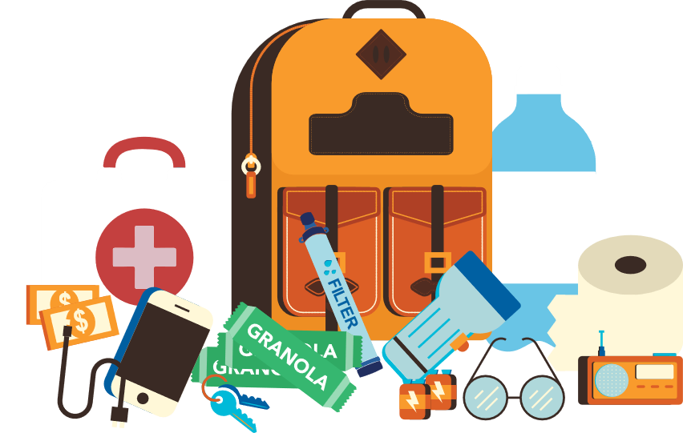
How should I store my kit?
Store these items in something that is portable and easily carried, like a backpack or tub/suitcase with wheels.
Keep this kit in a designated place and have it ready in case you have to leave your home quickly.
Make sure all family members know where the kit is kept.

Slide 6
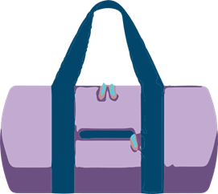
What other places should I have a kit?
Work
Be prepared to shelter at work for at least 24 hours. Your work kit should include food, water and other necessities like medicines, as well as comfortable walking shoes, stored in a “grab and go” case.
Car
In case you are stranded, keep a kit of emergency supplies in your car.

Slide 7
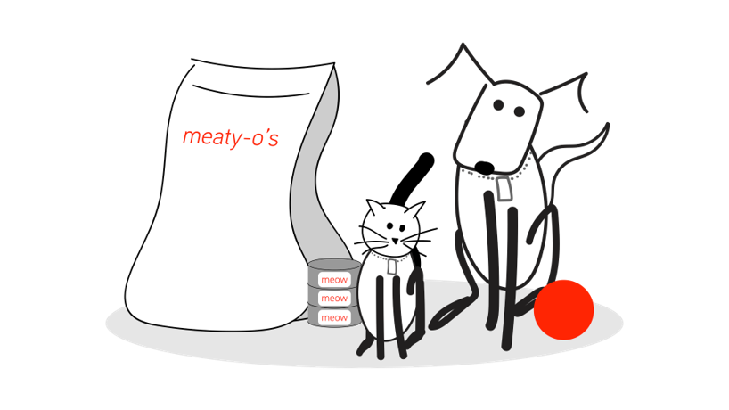
Pet Grab and Go
Pets need a grab and go kit, too!
Have two to three days of food, water, any of their medications, leashes and cages if reasonable.

