Slide 1
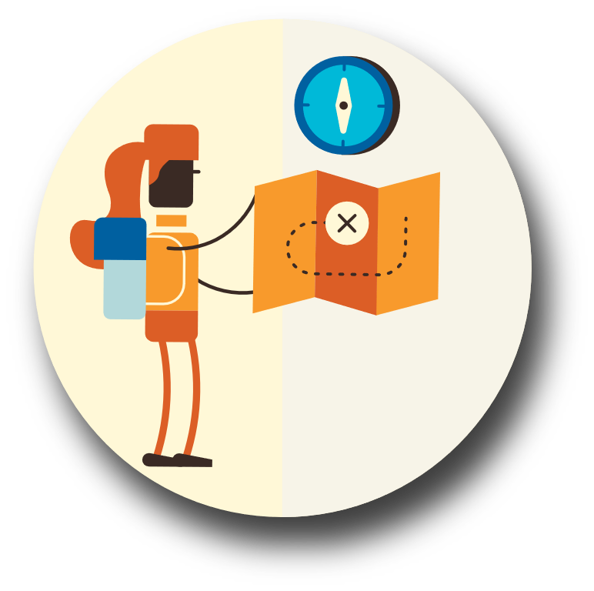
Create an Action Plan

Slide 2
What disasters or hazards can affect you?
Your community?
Your state?
Your family may not be together if a disaster strikes, so it is important to know which types of disasters could affect you and your family.

Slide 3
Put a plan together by discussing the questions below with your family, friends or household to start your emergency plan.
What is our shelter plan?
Where will we evacuate to?
What is our evacuation route?
Do we have a communication/reunification plan?

Slide 4
Put your plan into action
Teach children how to call 911. Show them how to use your cell phone.
Post emergency numbers in visible places
Show each family member how and when to turn off the water, gas and electricity at the main switches.
TIP:
• Check for adequate insurance coverage.
• Install an ABC fire extinguisher in your home. Teach each family member to use it and where it is kept.
• Install smoke and carbon monoxide detectors on each level of your home, in appropriate areas.

Slide 5
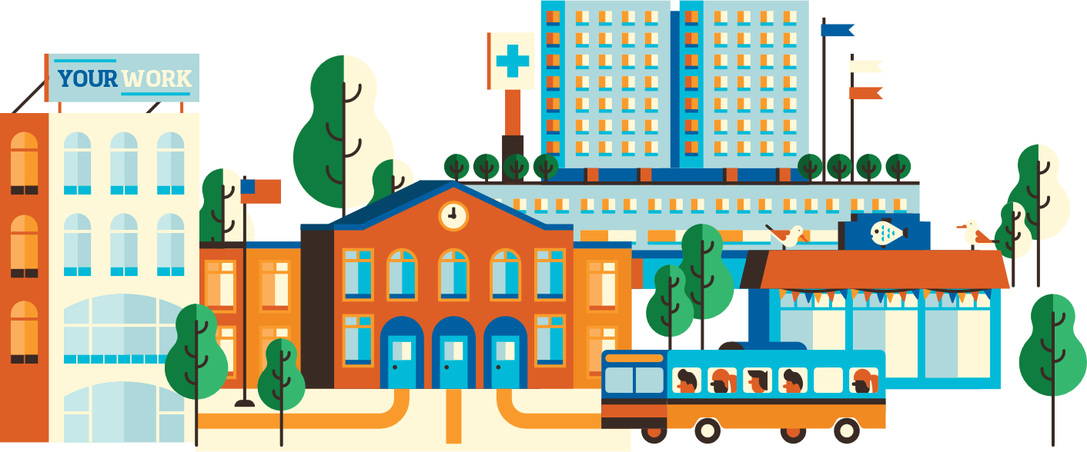
Evacuation Planning
Plan how you will leave and where you will go if you are advised to evacuate.
Always keep a half tank of gas in case of an unexpected need to evacuate.
Leave early enough to avoid being trapped by impending hazards.
Check with local officials before you travel back to areas impacted by the disaster.

