Slide 1
CATASTROPHE PREPAREDNESS TRAINING
[Date] [Organization]
(Insert logos)
Notes:
Instructor: insert logos for your organization (s).

Slide 2
AGENDA
Why prepare?
Disaster vs. Catastrophe
Potential impact
What to expect
What to do
The top three things that save lives
Survivor stories
Checklists to help prepare
Notes:
Instructor:
This is a rough agenda for this PowerPoint template. Adjust accordingly for your presentation.

Slide 3
WHY PREPARE?
In the last decade there have been XX global catastrophes.
Washington State has a wide variety of disaster threats. Can you name a few?
Notes:
Make the case for why people need to prepare: Example – here’s 4 events in 2011 that illustrate the impact of catastrophic events.
1.) 2011 USA Tornadoes
Cost: Damages (USA) $20-25 billion (Estimate as of July 1)
Extremely destructive tornadoes form most frequently in the U.S., Bangladesh and Eastern India, but they can occur almost anywhere under the right conditions. Tornadoes also appear regularly in neighboring southern Canada during the Northern Hemisphere’s summer season, and somewhat regularly in Europe, Asia, and Australia. As of December 9 2011, there have been 1,836 tornadoes reported in the US in 2011. This has been an exceptionally destructive and deadly year for tornadoes; worldwide, at least 576 people perished due to tornadoes.
Time span: January 2011 – ongoing
Maximum rated tornado: EF5 tornado Philadelphia; Mississippi on April 27; Hackle burg, Alabama on April 27; Smithville, Mississippi on April 27; Rainsville, Alabama on April 27; Joplin, Missouri on May 22; Piedmont, Oklahoma on May 24
Fatalities (USA): 552 fatalities (>5,370 injuries)
2.) Earthquake in Christ Church, New Zealand
The massive earthquake that affected New Zealand on February 22, 2011 left a tremendous impact on the country. John Key, the Prime Minister of the country marked it as the darkest day of the year. Hundreds of lives were lost and several people were trapped in the rubbles.
3.) The Great Tohoku Earthquake
On 12 March 2012, a Japanese National Police Agency report confirmed 15,854 deaths, 26,992 injured, and 3,155 people missing across twenty prefectures, as well as 129,225 buildings totally collapsed, with a further 254,204 buildings 'half collapsed', and another 691,766 buildings partially damaged. The earthquake and tsunami also caused extensive and severe structural damage in north-eastern Japan, including heavy damage to roads and railways as well as fires in many areas, and a dam collapse. Japanese Prime Minister Naoto Kan said, "In the 65 years after the end of World War II, this is the toughest and the most difficult crisis for Japan." Around 4.4 million households in northeastern Japan were left without electricity and 1.5 million without water.
4.) Puget Sound Snow Storms 2011: - Excerpt from USA today
SEATTLE – A monster Pacific Northwest storm coated Washington with freezing rain on Thursday and brought much of the state to a standstill as the Seattle airport temporarily shut down, tens of thousands of people lost power and hundreds of cars slid off roads a day after the region was hit with a major snowfall.
Washington State Emergency Management lists the wide variety of natural and technological catastrophic threats that can happen in the State:
Natural Hazards – reference: http://www.emd.wa.gov/hazards/haz_natural.shtml
Avalanches - Avalanches have killed more than 190 people in the past century, exceeding deaths from any other natural cause.
Drought - In the past century, Washington State has experienced a number of drought episodes, including several that lasted for more than a single season.
Earthquake - More than 1,000 earthquakes occur in Washington each year. A dozen or more are felt; occasionally, they cause damage.
Flood - Damage from flooding exceeds damage by all other natural hazards in Washington State.
Landslide - Landslide is the movement of rock, soil and debris down a hillside or slope. Landslides take lives, destroy homes, businesses, and public buildings, interrupt transportation, undermine bridges, derail train cars, cover clam and oyster beds, and damage utilities.
Severe Storm - All areas of Washington State are vulnerable to severe weather. A severe storm is an atmospheric disturbance that results in one or more of the following phenomena: strong winds, large hail, thunderstorm, tornado, rain, snow, or freezing rain.
Tsunami - The Pacific Coast, Strait of Juan de Fuca, Puget Sound, and large lakes are at risk from tsunamis, trains of powerful waves that threaten people and property along shorelines.
Volcano - Washington has five major volcanoes – Mount Baker, Glacier Peak, Mount Rainier, Mount St. Helens and Mount Adams. The risk posed by volcanic activity is not always apparent, as volcanoes can lie dormant for centuries between eruptions.
Wildland Fire - Short-term loss caused by wildland fire can include the destruction of timber, wildlife habitat, scenic vistas, and watersheds, and increase vulnerability to flooding . Long-term effects include smaller timber harvests, reduced access to affected recreational areas, and destruction of cultural and economic resources and community infrastructure.
Technological Hazards – Reference: http://www.emd.wa.gov/hazards/haz_technological.shtml
Abandoned Underground Mine - Underground coalmines present the largest abandoned mine hazard in Washington State. This is because of the extent of the mines and the urban development that has occurred around them.
Chemical - Nearly every community has a chemical hazard or a hazardous material transportation system that should be included in public education and emergency planning.
Civil Disturbance - Washington State witnessed race riots in the 1960s, protests against the Vietnam War in the 1970s, abortion clinic demonstrations in the 1980s, and civil disturbances and allegations of police brutality in the 1990s.
Dam Failure - Dam failure is the uncontrolled release of impounded water resulting in downstream flooding, which can affect life and property.
Hazardous Material - The Washington State Department of Ecology reported 3,988 confirmed hazardous materials spills in 1999. The continuing increase in responses to clandestine methamphetamine labs is of particular concern.
Local Hazard - Local hazards occur in jurisdictions but may or may not have a significant impact on large areas of the state.
Pipeline - Buried and exposed pipelines are vulnerable to breaks and punctures caused by earth movement, material failure, operator error, construction defects, and tampering. Fuel leaks cause hazardous materials spills, fires, and explosions.
Radiological - Radiological hazard is the uncontrolled release of radioactive material that can harm people or damage the environment. In Washington State, there have been no radiological releases affecting local jurisdictions from any nuclear power generating system.
Terrorism - Washington State is vulnerable to terrorist activity. Terrorism can be state sponsored or the outgrowth of a frustrated, extremist fringe of polarized and/or minority groups of people. Extremists have a different concept of morality than the mainstream society.
Transportation - Transportation systems in Washington State include road, air, rail, and maritime. Use of these systems and supporting transportation vehicles create the opportunity for accidents, emergencies, and disasters. Transportation hazards are natural or human caused.
Urban Fire -Urban fire occur primarily in cities or towns with the potential to rapidly spread to adjoining structures. These fires damage and destroy homes, schools, commercial buildings, and vehicles.

Slide 4
WHY PREPARE: Earthquake threat in Washington State
Earthquakes represent the most comprehensive catastrophic event that Washington State will face.
If you are prepared for the consequences of an earthquake, you are prepared for most of the other types of catastrophic events
Notes:
Many types of catastrophes and disasters have similar consequences. Example:
Earthquakes and snowstorms both impact roadways and bridges and delay responders from getting where needed
High Wind events and Earthquakes both impact the electrical grid
All events will overwhelm the 911 system
All events will cause people to need to help each other instead of relying on professional responders such as police and fire.
Encourage participants to focus on the consequences of the events instead of the wide variety of events.
“Since we already know, through past experience, what the consequences are, you can successfully plan and prepared to make it through the event. You don’t need a plan for each type of event, just a plan that deals with the anticipated consequences.”

Slide 5
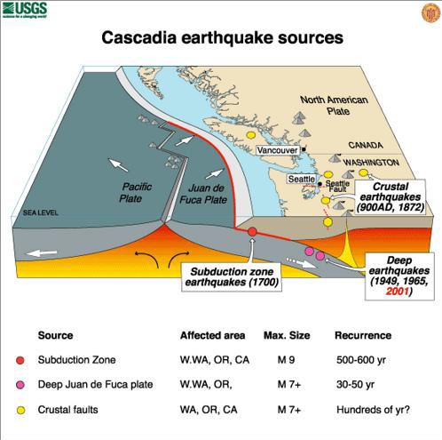
Cascadia Earthquake Sources
Notes:
This slide is optional. It’s a lot of details about earthquakes and if you are not comfortable with geology and statistics, it may be better to skip this slide. There is another school of thought: If the audience has made the effort to attend the program, then it’s highly likely that they already know that the threat of earthquake exists and they don’t need as much details.
Instructor talking points for the slide:
Washington State is one of the most seismically active areas in the country. The state has 3 primary types of earthquakes:
Subduction Zone:
same type of earthquake that happened in Japan in 2011.
Will likely be a magnitude 8 - 9+
Will likely cause a tsunami off the coast
Will shake for minutes
Approximate 50 year probabilities: 10 – 14% (USGS Statistic)
Deep Earthquake – Juan de Fuca Plate
Occurred in 1949, 1959 and 2001
Historically a 6 – 7.5 Magnitude
Long duration shaking – 45 – 60 seconds
Approximate 50 year probabilities: 84% (USGS Statistic)
Crustal Fault
Washington State has hundreds of shallow crustal earthquakes each year. Most are small, crustal earthquakes that are barely felt. These earthquakes are random shallow. Typically between M 3 to 4 however, they can reach a magnitude 6.5 – 7.0 as in the case of the Seattle Fault.
Approximate 50 year probabilities: 15% (USGS Statistic)

Slide 6
WHY PREPARE?
Catastrophes can happen at any time, anywhere
Home, work, car, school
It could take 7 to 10 days to get help/resources
No power, water, shelter, roads, food, fuel, etc.
Having a plan will help you feel safe and in control
Protect your family and pets
Notes:
This slide sets the stage for why people should prepare.
Catastrophes can happen at any time, anywhere
Consequence: You could be at Home, work, car or school
It could take 7 to 10 days to get help/resources – (and maybe a bit longer, depending on the type of event and the damage.)
Consequence: No power, water, shelter, roads, food, fuel, etc. Cascading effects: cash machines won’t work, getting prescription meds will be difficult; grocery stores and hardware stores will run out of supplies quickly and the resources to restock will be delayed)
Having a plan will help you feel safe and in control
Protect your family and pets – You have the power and the ability to get ready for these consequences and therefore be able to help your family and others.
(this supports a key finding from the research – that people want to feel safe and in control. )

Slide 7
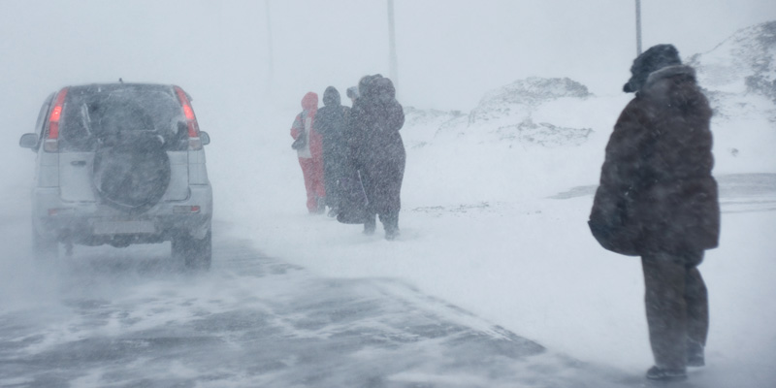
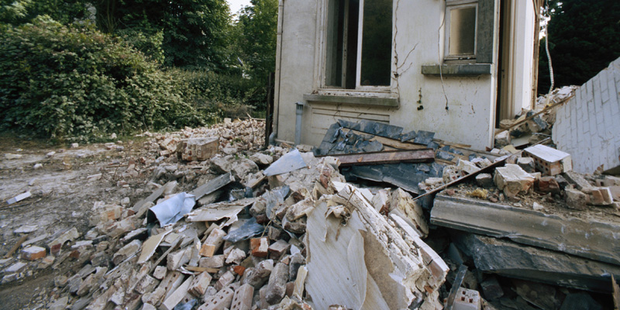
DISASTER VS CATASTROPHE
DO YOU KNOW THE DIFFERENCE?
Notes:
Ask the audience what they think the differences between Disaster and Catastrophe.
Activity Option:
Have an easel & paper or a whiteboard
Draw two columns – one for disaster and one for catastrophe
Have audience describe the characteristic of each – click to the next slide for highlighting disaster

Slide 8
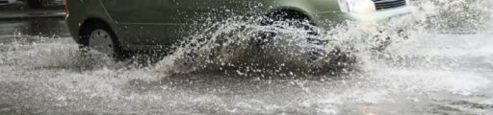
DISASTER VS CATASTROPHE
Disasters
Major snow and wind storms, flooding, mild earthquake
Preparing for at least 3 days will address most disasters in Puget Sound region
Notes:
Characteristics of a disaster:
Potential responses from the audience:
Impacts lots of people
Professional responders overwhelmed
Impacts infrastructure
Preparing for at least 3 days will probably get you by
Examples:
Small earthquake
Snow storms
Severe wind events

Slide 9
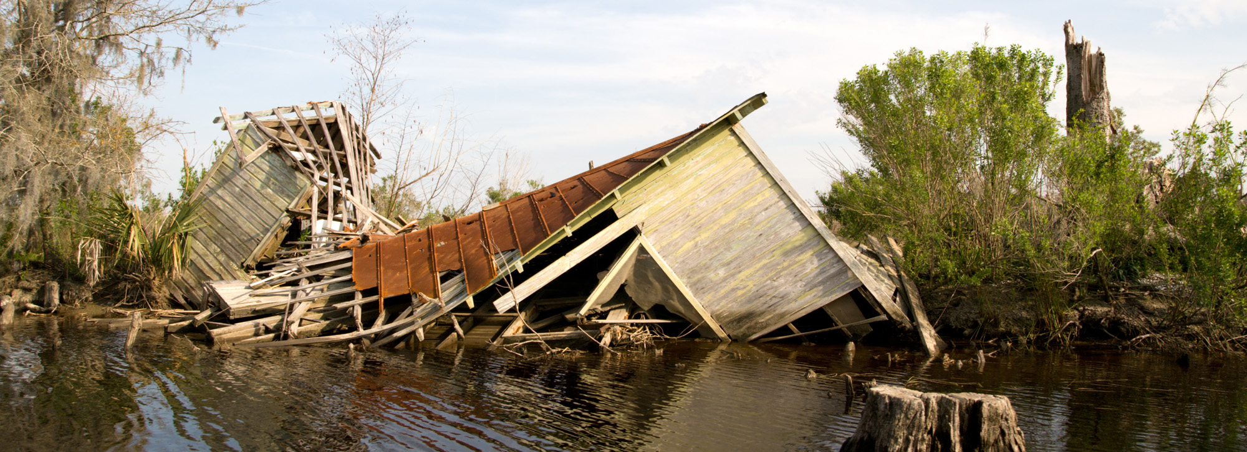
DISASTER VS CATASTROPHE
Catastrophe
Hurricanes, tornados, major earthquakes, tsunamis
Must prepare for at least 7 to 10 days
Notes:
Characteristics of a catastrophe:
Potential responses from the audience:
Impacts even more people in a wider geographical area
Professional responders overwhelmed and it will require help from outside the damage area to respond to the problems
Impacts infrastructure will be great and will require a long term recovery
Preparing for at least 7 – 10 days is necessary. In addition, you will need a “collective response” of family, friends, co-workers and neighbors” to make it through.
Examples:
Major earthquake
Volcanic eruption
Tsunami

Slide 10
POTENTIAL IMPACT
Notes:
Emergency:
Happens every day. Typically would be able to call 911 and receive help from professional responders
Can you give examples?
House fire, medical emergency, injury, car accidents, civil disobedience/crime to persons.
Disaster:
Happens every month, somewhere in the US. Will likely cause infrastructure impacts such as interruption to power, closed roadways, flooding, etc.
Can you give examples: Severe weather, ice storms, flooding, small earthquakes, hazardous materials spills, wildland fires, etc.
Catastrophe:
Happens somewhere in the world every year. Causes major infrastructure impacts and loss of life.
Can you give some examples: Large earthquakes, Tsunami, droughts, flooding, hurricanes, volcano eruption,

Slide 11
POTENTIAL IMPACT
Recent Weather Events Midwest/Southeast tornadoes May 22-27, 2011 Over 180 tornadoes were produced during this event, with an EF-5 tornado devastating Joplin, Missouri. The Joplin tornado killed approximately 141 people, making it the deadliest single tornado since modern tornado record-keeping began back in 1950 – 177 people died throughout this time period. Tornado brought $4.9 billion in insured losses with total losses greater than $7 billion.
Notes:
These three slides highlight catastrophic events and the outcomes of those events.
It is setting the stage for slide 14 which will ask “How long do you think it will take for essential services to be restored?”

Slide 12
POTENTIAL IMPACT
Japan Earthquake – 9.0
Tsunami reached as high at 133 feet traveling up to 6 miles inland
Destroyed or damaged over 270,000 buildings
At one time left 386,739 homeless
3,824 still missing and 15,824 dead
Source: Japan thank you video
Notes:
This earthquake was along the pacific rim of fire and was a subduction zone earthquake. Washington state has the same geological threat.

Slide 13
POTENTIAL IMPACT
Hurricanes Katrina & Rita
More than 1.5 million people were directly affected and more than 800,000 citizens were forced to live outside of their homes
The storms had a massive physical impact on the land, affecting 90,000 square miles – an area the size of Great Britain.
Over 80 percent of the city of New Orleans flooded.
Source: http://www.dhs.gov/xfoia/archives/gc_1157649340100.shtm

Slide 14
POTENTIAL IMPACT
In these types of events, how long do you think it will take for essential services to be restored?
Notes:
Total recovery will take years!
Joplin:
One year after Joplin tornados, the school district is still not recovered: The 2011 twister completely destroyed three schools, including Joplin High School, and damaged six others. The school district broke ground on four new schools earlier in the week to mark the one year anniversary,
Article: Feds Designate $800,000 For Joplin School Recovery; By: Eli Yokley, Missouri News Horizon Updated: May 24, 2012
Katrina:
“Six years after Hurricane Katrina, metro New Orleans is deep into its recovery from the catastrophe.”
Article: The agenda pending for our recovery from Hurricane Katrina: An editorial published: Sunday, August 28, 2011, 7:01 AM
Japan:
A year after the March 11 tsunami, the town of Rikuzentakata remains on life support. Companies created jobs to keep residents from leaving but have been unable to fill all the positions, despite high unemployment. WSJ's Daisuke Wakabayashi reports.
Article: An Altered Japan Marks a Year After Quake - Country Commemorates Anniversary With Prayers for Victims, Reflections on Losses and Protests Against Nuclear Energy From: JAPAN NEWS Updated: March 12, 2012, 11:03 a.m. ET

Slide 15
WHAT TO EXPECT?
Power will be out
No heat, cooking, refrigeration, no pump for well water access, no gas stations or cash machines
Roads will not be passable
You will be stuck where you are, emergency response will be delayed
Communication lines will be down
May have a difficult time getting through to 911, no way to reach family members
Stores will be closed or empty
No access to food/supplies or fuel
If you don’t have it now, you won’t be able to get it no matter how hard you try

Slide 16
WHAT TO DO?
Work together; pool resources
Don't overburden 911
Only call if you have a life-threatening emergency
Listen for emergency alerts via radio
Identify alternate ways to communicate
Amateur radio, text messages, etc.
Find missing loved ones
i.e. Google people finder, social media, Red Cross
If necessary, shut off utilities such as natural gas, water and electricity
Link to website for when to shut off utilities
Notes:
Note: Customize the alternate ways of communication to fit what you do in your jurisdiction.

Slide 17
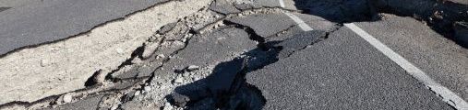
THE TOP 3 THINGS
WHAT DO YOU THINK YOU NEED TO DO TO PREPARE?
Notes:
Ask the audience: “what are the three most important things you feel you need to do?”
Optional:
1.) Instructor can use the white board or easel pad to write what the audiences identifies as important.
2.) You can give the audience paper and pen and have them write down the three most important things they feel they need to do to get ready. “what concerns you the most?” or “if you knew the earthquake was going to happen in two days, what are the three most important things you would do tomorrow to get ready ?” (can’t be take a plane out of town….:+)

Slide 18
THE TOP 3 THINGS
Notes:
Here’s the top three things we recommend to do:

Slide 19
SURVIVOR STORIES
Insert video
Notes:
HAVING A PLAN AND BEING PREPARED Judson and Terri Rollins Hurricane Ike

Slide 20
THE TOP 3 THINGS
Plan for people, pets and property
Make a family emergency communication plan; identify out-of-state contact
Review and practice your emergency plan
Notes:
Instructor to audience: You can start with any one of these steps; you don’t have to do them all at once. You need to start somewhere and then you can continue to build on what you have done.

Slide 21
SURVIVOR STORIES
Insert video
Notes:
BUILDING A KIT Lyz Staman Japan earthquake and tsunami

Slide 22
THE TOP 3 THINGS
For 7 to 10 days: what would you need?
What important documents would you need?
What tools & equipment would you need?
How would your kit differ for your home, office or car?
Notes:
Ask audience: If you knew a disaster was coming next weekend, what do you think you would need?

Slide 23
SURVIVOR STORIES
Insert video

Slide 24
THE TOP 3 THINGS
Plan together: create networks of neighbors and co-workers; pool resources
Get first aid and CPR training (Red Cross, CERT). Learn how & when to turn off your utilities
Learn how to reduce hazards (e.g., secure heavy furnishings, line shelves, strap water heater, identify homes with gas service, etc.)
Notes:
Instructor to audience: This is just a quick guide of things you can do. You should tailor it to your own needs.

Slide 25
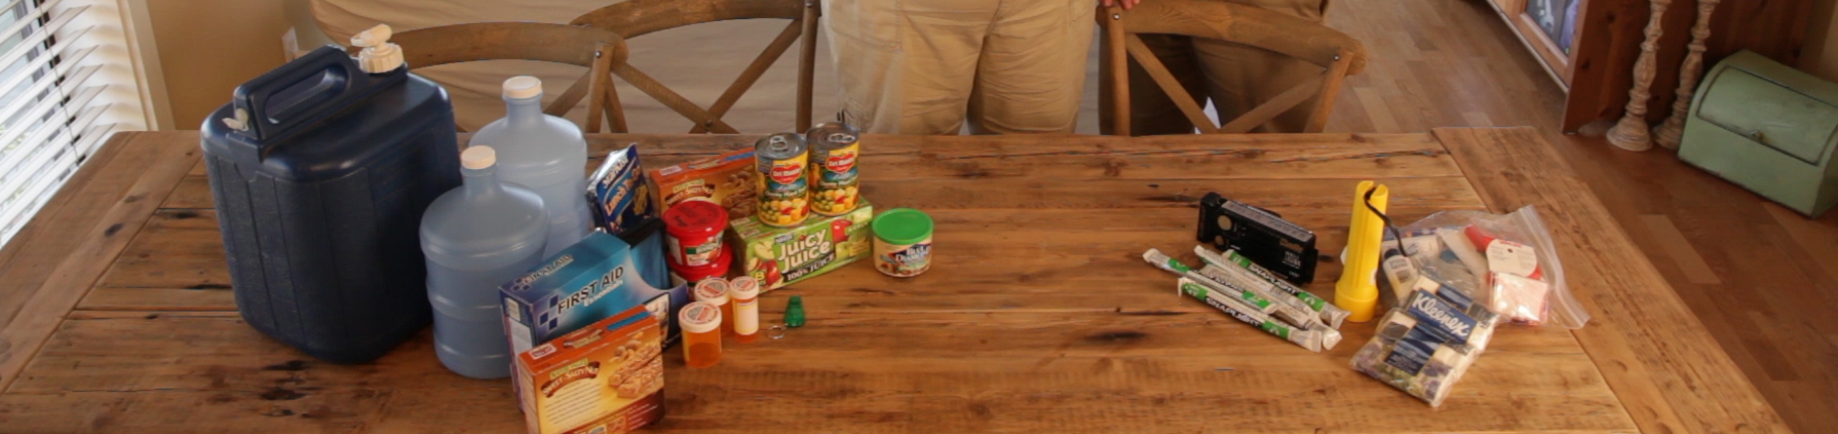
HOW INFORMED DO YOU THINK YOU ARE NOW COMPARED TO BEFORE YOU HEARD THIS INFORMATION?
What are three new things you learned…
to make it through?
Notes:
Ask audience: What are three things you heard in this presentation that were new information to you?
Ask audience: What is the most important preparedness action you need to do to prepare?

Slide 26
Preparing today will increase your chances of survival.
What will you do tomorrow to get prepared?
Notes:
Instructor: Ask audience one thing they will do tomorrow do get prepared.

Slide 27
RESOURCES
Checklists and websites
to help you prepare
Notes:
The following 6 slides are the checklists that have been created from the web site. Choose which checklists are best suited for the audience and delete the rest. Then save the presentation as different from the original template.

Slide 28
CHECKLIST HOME
Water – one gallon per person per day for drinking and sanitation
Food – at least 7 to 10 day supply of non-perishable food (per person)
Cash – ATMs won’t work without electricity
Battery-powered radio and extra batteries
Flashlight and extra batteries
First aid kit
Whistle to signal for help
Filter mask or cotton t-shirt to help filter the air
Moist towelettes for sanitation
Wrench or pliers to turn off utilities
Manual can opener for food
Plastic sheeting and duct tape to shelter-in-place
Garbage bags and plastic ties for personal sanitation
Unique family needs: prescriptions, infant supplies, pet supplies and important family documents

Slide 29
CHECKLIST CAR
Portable water/non-perishable food
Flashlight/extra batteries
Cell phone charger/extra battery
First aid kit, medicines
Jumper cables
Emergency flares
Tire jack & spare tire, fix-a-flat
Warm clothes, sturdy shoes, blanket
Chains, ice scraper, toolkit

Slide 30
CHECKLIST OFFICE
Portable water/non-perishable food
Cell phone charger/extra battery
Emergency contact plan
Medicines
Comfortable walking shoes
Include in “Grab and go” container

Slide 31
CHECKLIST INFANTS
Diapers
Bottles
Formula
Baby food
Wet wipes
Pediatric pain relievers
Pacifiers
Toys
Books

Slide 32
CHECKLIST LIMTED MOBILITY
Extra battery/charger for wheelchair/scooter
Heavy pair of gloves
Patch kit for tires
Lightweight, manual wheelchair
Cane/walker
Whistle

Slide 33
CHECKLIST PETS
Water & dry pet food
Extra leash & collar with ID tags
Pet carrier
Name & phone of veterinarian
Copy of vaccination records
Pet chip ID number
Photo

Slide 34
RESOURCES
Local/Regional Preparedness www.makeitthrough.org
Training American Red Cross : www.redcross.org Community Emergency Response Team (CERT) : www.citizencorps.gov
Community Preparedness Citizen Corps : citizencorps.gov
Notes:
Note to instructor: You should add your local office of emergency management and contact information to this list.

Slide 35
RESOURCES
Federal Ready America (FEMA) : www.ready.gov
Federal Emergency Management Agency : www.fema.gov
Department of Homeland Security : www.dhs.gov
Notes:
Note to instructor: You should add your local office of emergency management and contact information to this list.

Slide 36
(Insert logos)
Notes:
Instructor: Insert appropriate logos for your organization (s).

